Slide 1
RSA (Rivest Shamir Adleman) cryptosystem

Slide 2
RSA is one of the first public-key cryptosystems and is widely used for secure data transmission. In such a cryptosystem, the encryption key is public and distinct from the decryption key which is kept secret. Invented by Rivest, Shamir and Adleman.

Slide 3
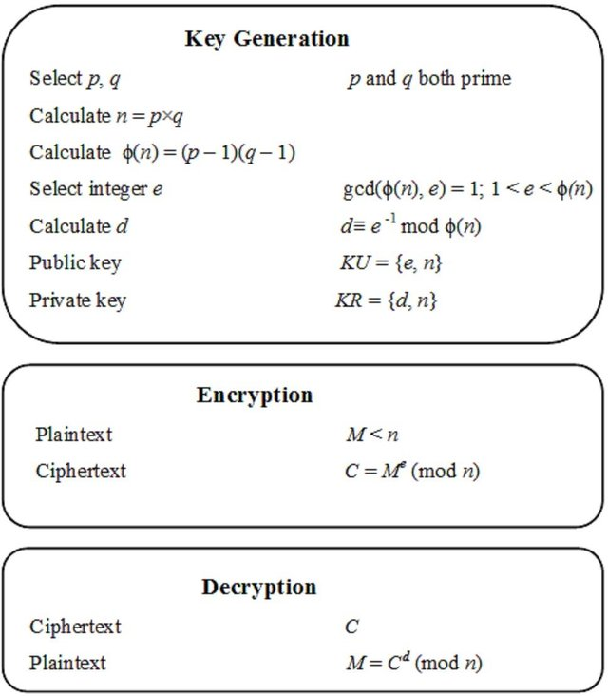
Key generation, encryption and decryption algorithm

Slide 4
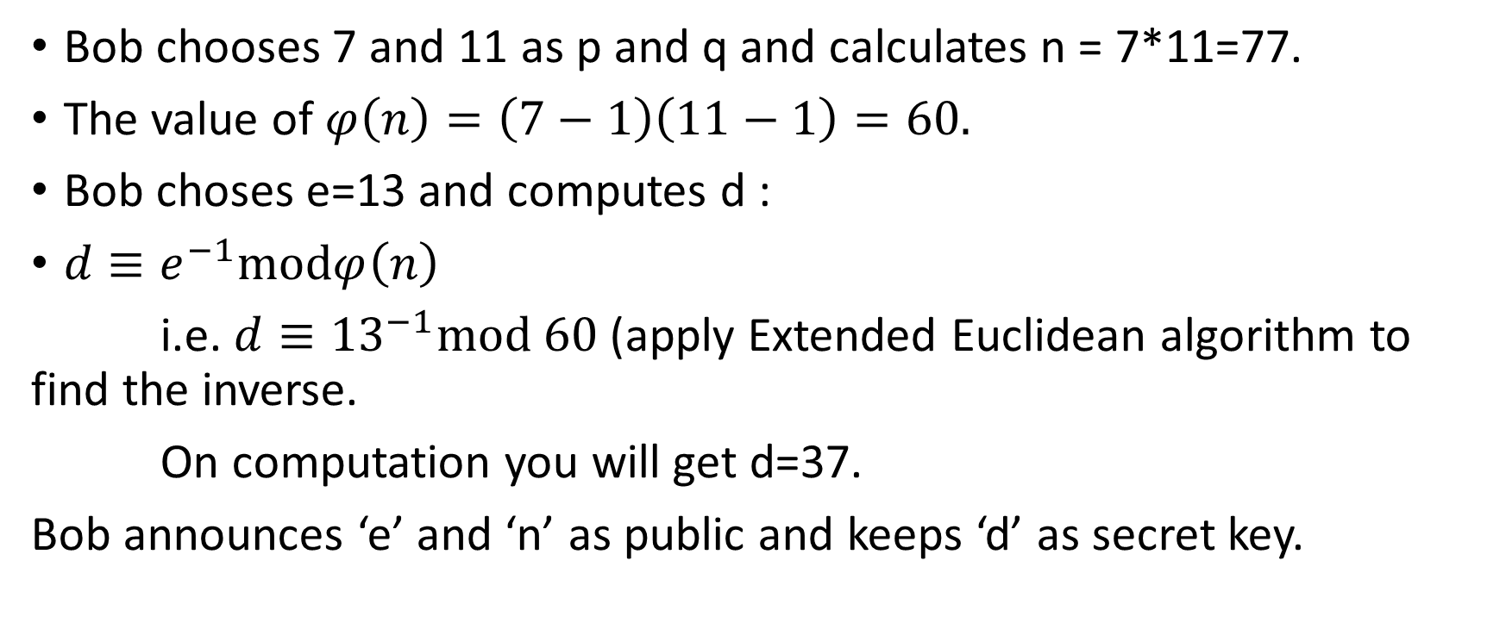
Example:
Bob chooses 7 and 11 as p and q and calculates n = 7*11=77.
The value of $φ\left(n\right)=\left(7−1\right)\left(11−1\right)=60.$
Bob choses e=13 and computes d :
$d≡e^{−1}modφ\left(n\right)$
i.e. $d≡{13}^{−1}mod 60$ (apply Extended Euclidean algorithm to find the inverse.
On computation you will get d=37.
Bob announces ‘e’ and ‘n’ as public and keeps ‘d’ as secret key.

Slide 5
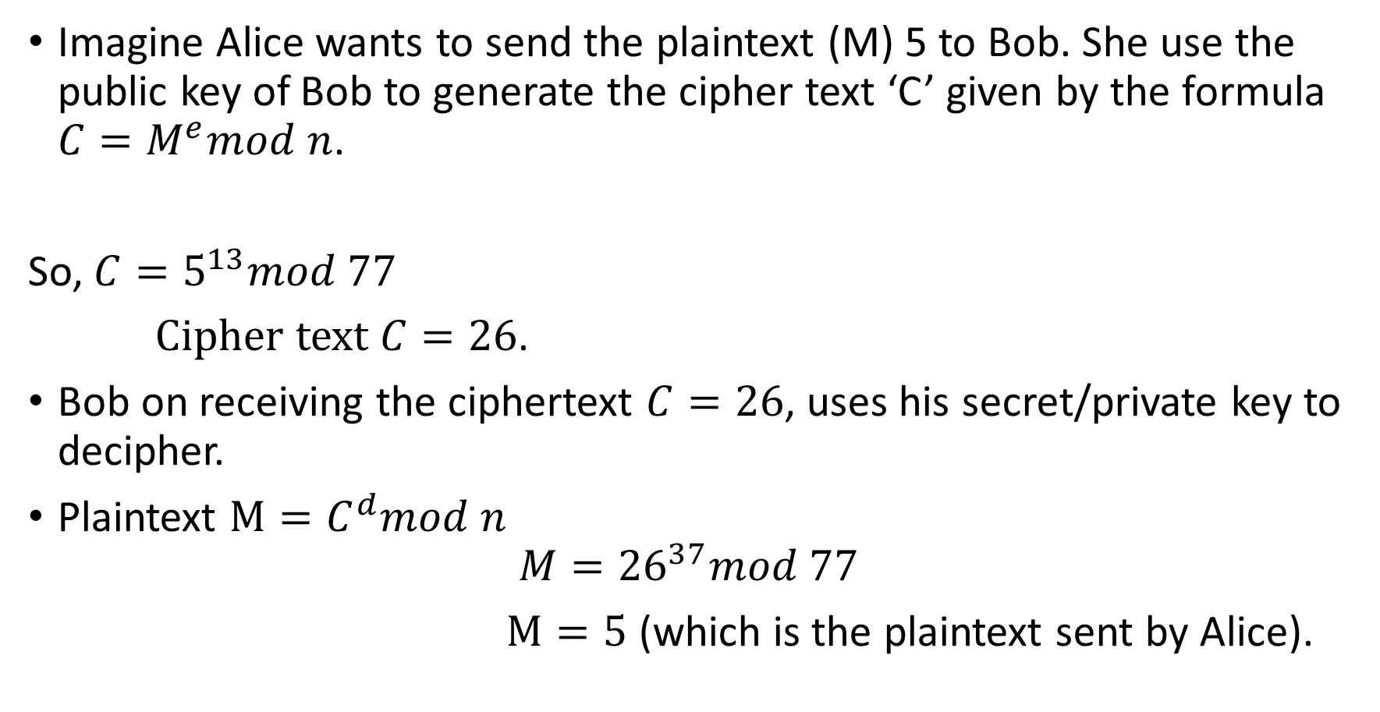
Imagine Alice wants to send the plaintext (M) 5 to Bob. She use the public key of Bob to generate the cipher text ‘C’ given by the formula $C=M^{e}mod n$.
So, $C=5^{13}mod 77$
$Cipher text C=26$.
Bob on receiving the ciphertext $C=26$, uses his secret/private key to decipher.
Plaintext $M=C^{d}mod n$
$$M={26}^{37}mod 77$$
$M=5$ (which is the plaintext sent by Alice).

Slide 6
Solve this as assignment :
Let p=23, q = 31, Bob Choses e=83. Compute d? If Alice wants to sent the text “NITS”, the ASCII code is (78, 73, 84,83). Find the cipher text for each ASCII code. Convert back the cipher text to plaintext using the private key ‘d’.
Solve and send back on next Monday (30/3/2020).

